Slide 1


Introduction to Linux

Slide 2



What we are going to cover
What is Linux?
How do we use Linux?
What are Linux Distributions?
Simple Linux commands
What can you do with Linux?

Slide 3

What is Linux?
Linux is an operating system written by volunteers called contributors
Linux allows you to use computer hardware to do things
The Linux ecosystem provides tools to run varied services such as web services or compute modules for advanced AI

Slide 4
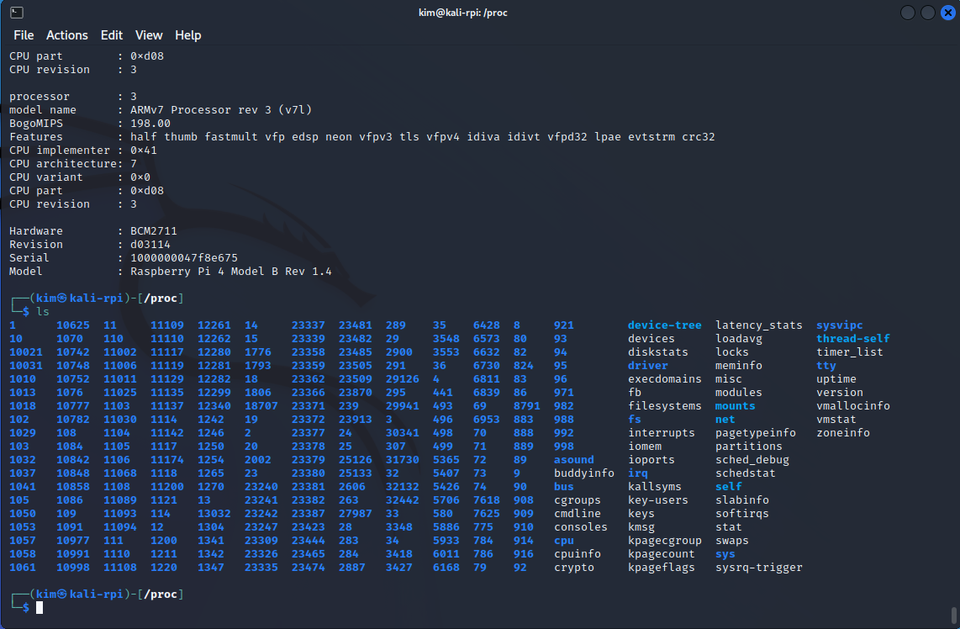
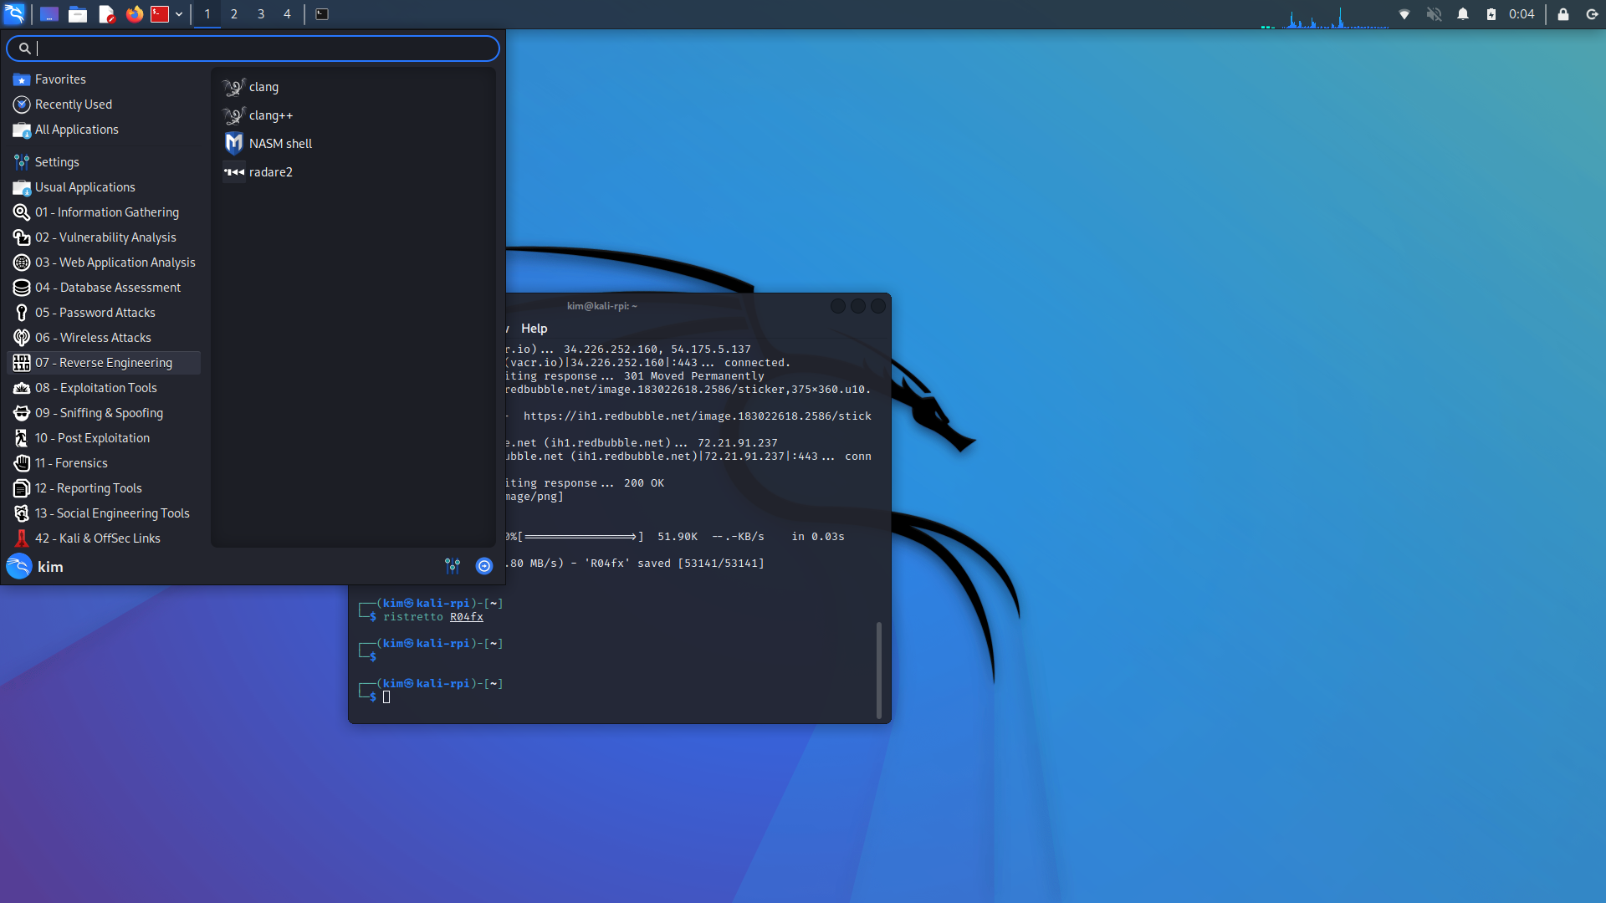
How do we use Linux?
Command Line
Graphical User Interface

Slide 5
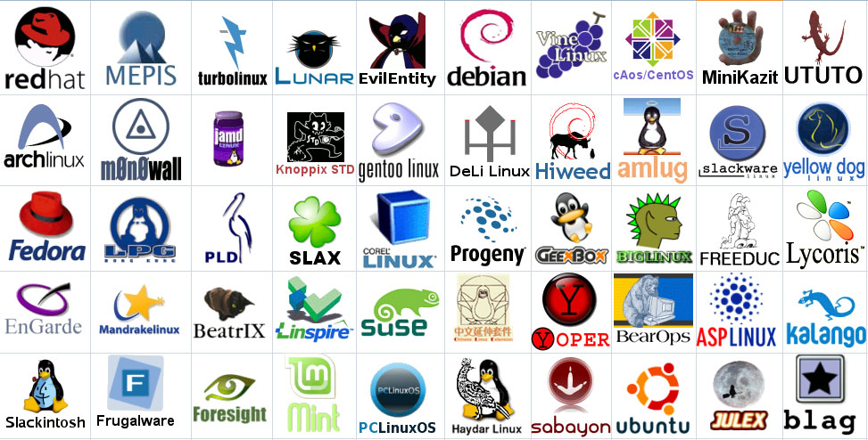
What is a Linux Distribution?
A Distribution is a series of packages bundled together by a group of maintainers.
The packages and the kernel (heart) make up a Distribution.
Some Distributions are maintained by companies (Debian, Ubuntu, Red Hat, Oracle, SuSE)

Slide 6
Simple Linux Command Reference
ls : Lists the files in a directory
cd : change directory
pwd : shows the present working directory
cat : concatenates a file – or displays it to the screen
less / more : pagination of output
tar : Tape ARchive. Old backup software, now used as a primitive way to package files.
cp / rm / mv : copy, remove and move a file
compress / gzip / bzip2 / xv : compression tools to make files smaller
touch : create a file or change its timestamp
useradd : create users
chown / chgrp : change owner and group permissions on a file
awk / sed / grep : modification of data in files or on the screen
echo : repeats a command to the screen
Pipes “|, <, >” : allow redirection of data between processes

Slide 7

What can you do with Linux?
Android Cell Phones
Super Computers
Microcomputers
Web Services
Data Processing
AI/ML
Cloud Servers
Databases
Game Consoles
Graphics Design
Video Authoring
Embedded Systems

